Slide 1
Battle of Neighbourhoods in Toronto
Francisco Tarantuviez

Slide 2
Introduction

Slide 3
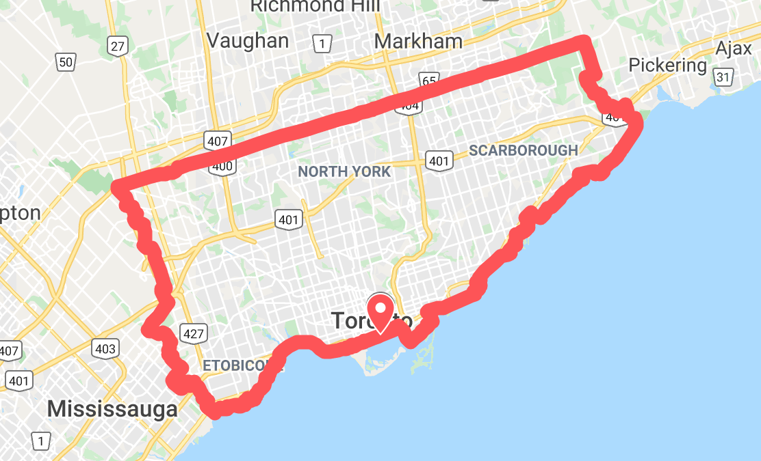
Context

Slide 4
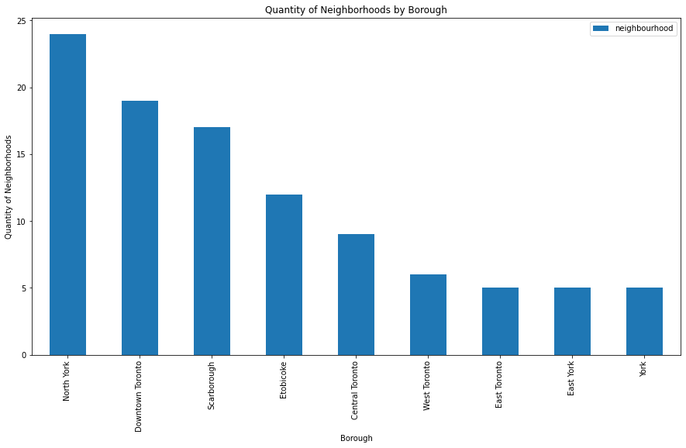

Slide 5
Problem to solve
Currently living in West Toronto, Dufferin. Neighbourhood that I loved caused it’s amenities and venues.
A “dream” job offer.
Job neighbourhood: Cedarbrae (19.58km from my actual neighbourhood)
Find
A new neighbourhood near to the job location and similar to my current Dufferin.

Slide 6
Data

Slide 7
Data Sources
Feature Selection
Wikipedia
Foursquare API
Pygeo
Most common venues for each neighbourhood.
Distance in kilometers from Cedarbrae.

Slide 8
Exploratory Data Analysis

Slide 9
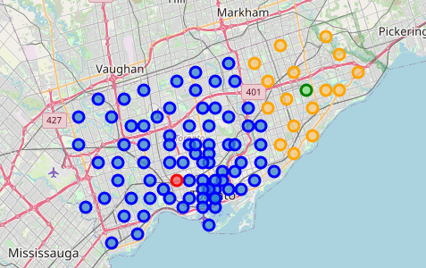
Dufferin - Cedarbrae

Slide 10
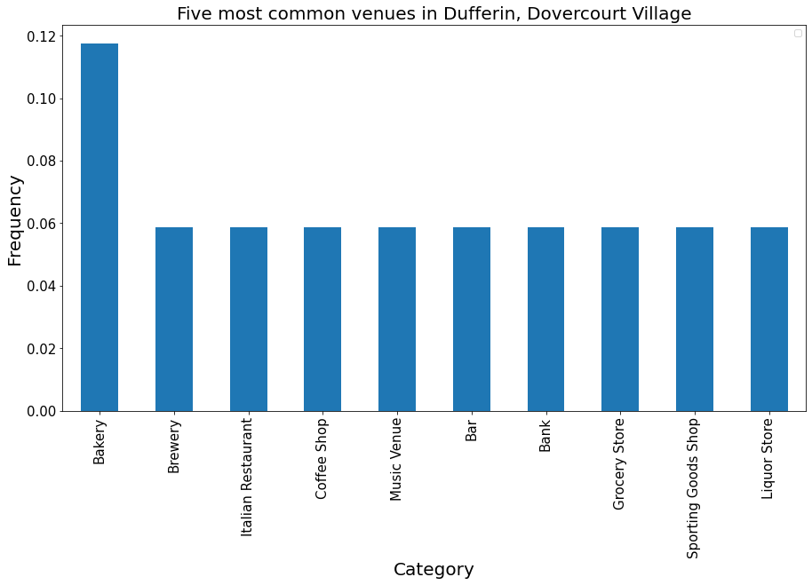
Dufferin Venues

Slide 11
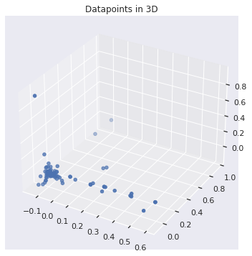
Data points
Distribution

Slide 12
Modeling

Slide 13
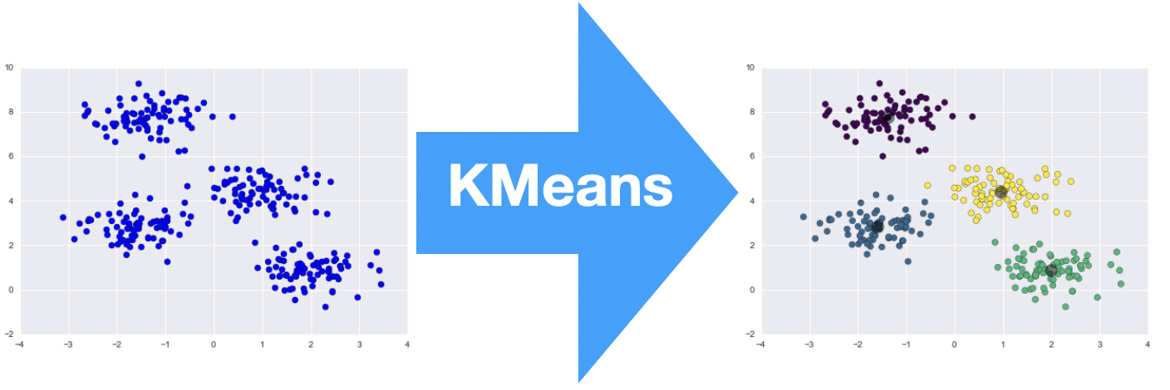
Clustering | K-Means

Slide 14
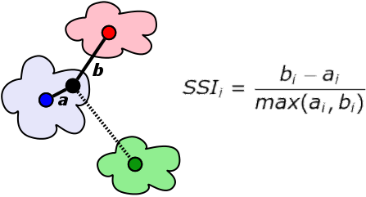
Silhouette Score
Metric measurement of our model performance
Is a measure of how similar an object is to its own cluster (cohesion) compared to other clusters (separation).

Slide 15
Finding the best number of k
Number of cluster with the best score
Iteration over integer ranges [2,8)
Train the model
Save differents scores
Keep the k value with the best score

Slide 16
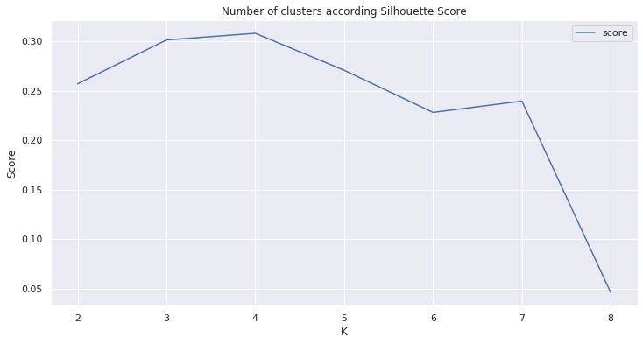
Best number of clusters

Slide 17
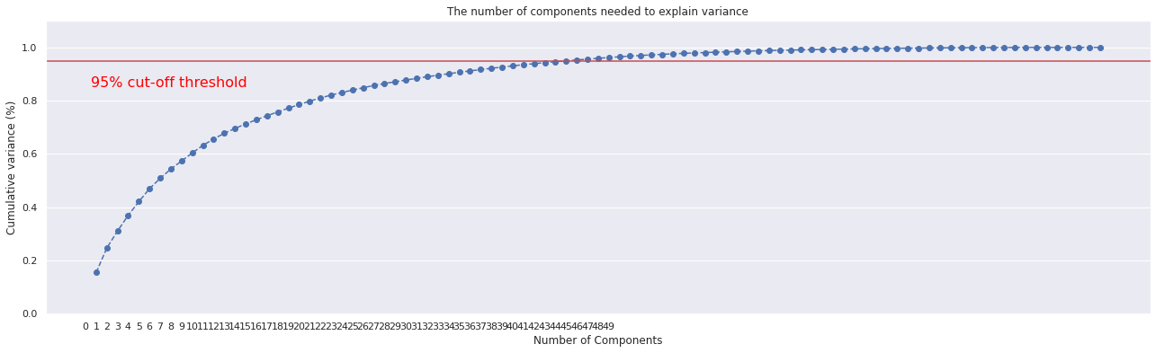
Dimensionality Reduction with PCA
To improve the performance of the algorithm, reduce the dimensions is a good way to achieve it.
Number of features by variance

Slide 18
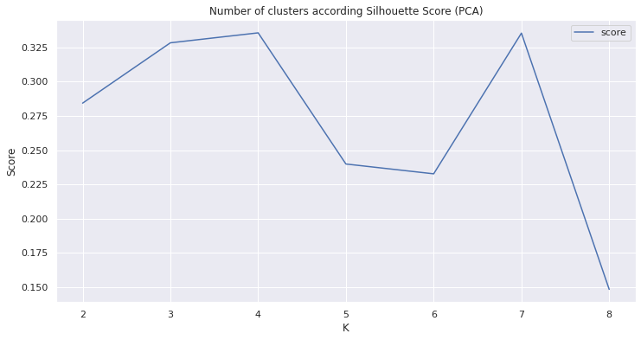
Silhouette Score after PCA

Slide 19
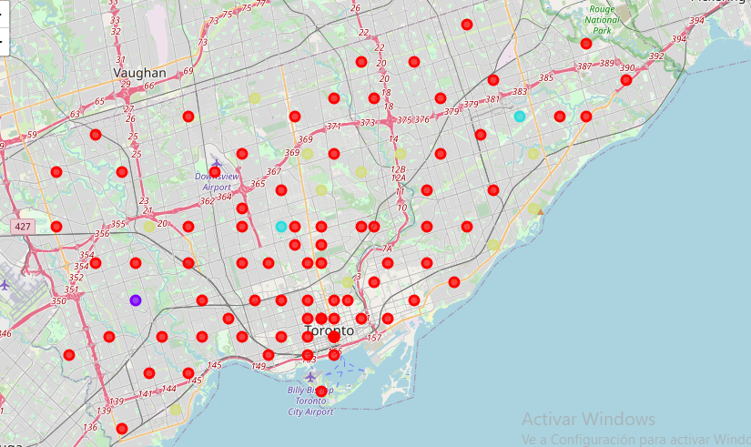
Clusters

Slide 20
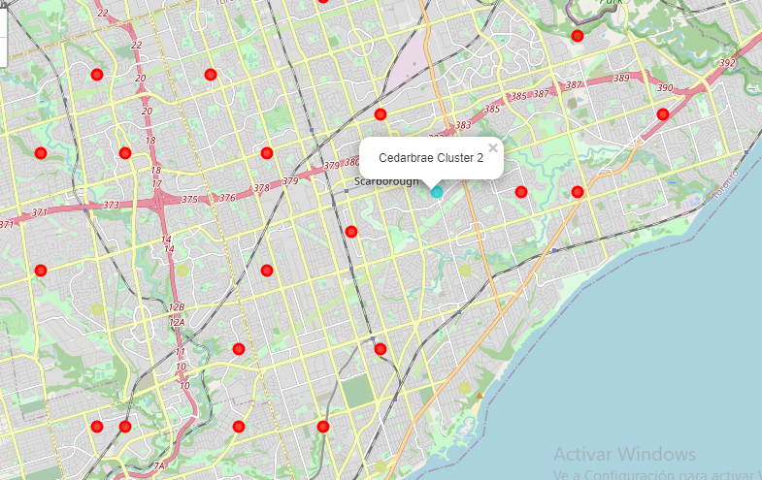
Limit Radius
(12.57km)

Slide 21
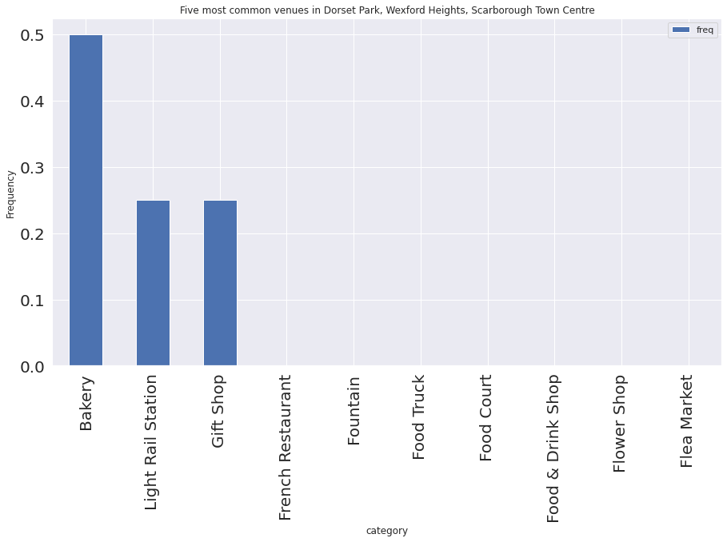
Dorset Park Venues

